Slide 1
WEEKLY CURRENT AFFAIRS BY: DEEPAK SINGHAL SIR 22-30 September 2024
EDUPREPARATOR www.edupreparator.com
9990901901, 9319737316

Slide 2
First Anniversary of PM Vishwakarma Scheme:
The Ministry of Skill Development and Entrepreneurship (MSDE) will be celebrating the 1st Anniversary of the PM Vishwakarma Scheme on September 20, 2024.
The scheme, launched by Prime Minister Narendra Modi on September 17, 2023, focuses on enhancing traditional artisans' skills (Vishwakarmas) by providing them with modern tools, techniques, and credit support for expanding their businesses.
The ultimate goal is to bring Samman (respect), Samarthya (capability), and Samriddhi (prosperity) to the Vishwakarmas.

Slide 3
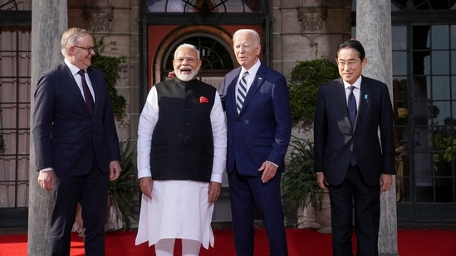
Prime Minister Narendra Modi's Upcoming Visit for the Quad Summit:
Prime Minister Narendra Modi is set to attend the Quad Leaders’ Summit in Wilmington, Delaware, from September 21 to 23, 2024.
The visit underscores critical themes such as the development of the Indo-Pacific region and the pursuit of sustainable development goals, as stated by Foreign Secretary Vikram Misri.

Slide 4
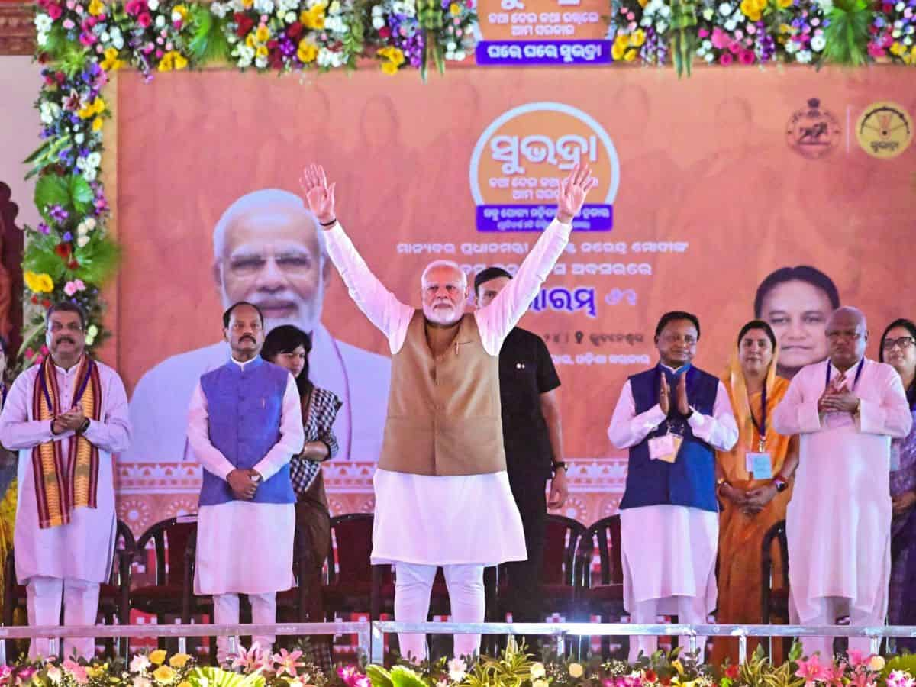
Prime Minister Narendra Modi Unveils ‘SUBHADRA’ - Odisha’s Largest Women-Centric Scheme in Bhubaneswar
The Prime Minister, Shri Narendra Modi launched ‘SUBHADRA’, the flagship Scheme of Government of Odisha, in Bhubaneswar, Odisha.
It is the largest, single women-centric scheme and is expected to cover more than 1 crore women.
Key Highlights :
Financial Assistance:The scheme provides ₹50,000 to each eligible beneficiary over a period of 5 years (2024-25 to 2028-29).
Beneficiaries will receive ₹10,000 annually in two equal installments, directly credited to their Aadhaar-enabled and DBT-enabled bank accounts.
Eligibility:The scheme is targeted at women aged 21-60 years.
About Odisha :
Governor : Raghubar Das
Chief Minister : Mohan Charan Majhi
Capital : Bhubaneswar

Slide 5
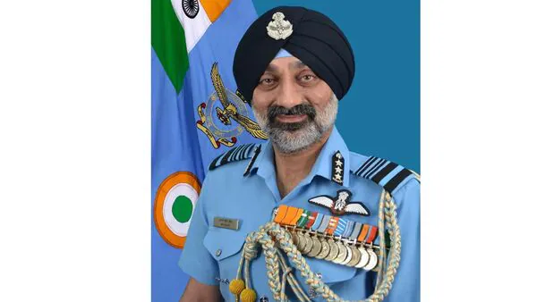
Vice Chief of the Air Staff Air Marshal Amar Preet Singh named as the next Chief of the Air Staff
Air Marshal Amar Preet Singh, currently Vice Chief of the Air Staff, appointed as the next Chief of the Air Staff (CAS).
He will assume the position in the rank of Air Chief
Marshal effective from September 30, 2024.
He succeeds Air Chief Marshal Vivek Ram Chaudhari, who retires on the same day.
About Air Marshal Amar Preet Singh :
He Commissioned into the fighter pilot stream of the Indian Air Force in December 1984.
He Has nearly 40 years of service with diverse Command, Staff, Instructional, and Foreign appointments.
He Accumulated over 5,000 hours of flying experience on various fixed and rotary-wing aircraft.

Slide 6
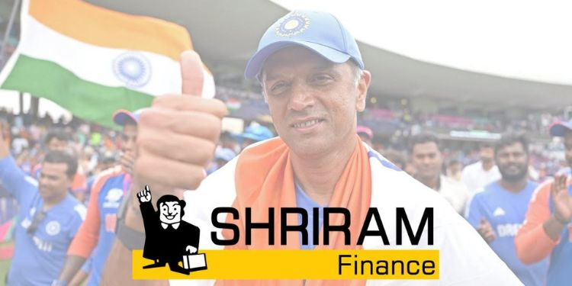
Shriram Finance appoints former Indian Cricket Team Captain and Coach Rahul Dravid as brand ambassador
Shriram Finance announced the onboarding of former Captain and Head Coach of the Indian Cricket Team, Rahul Dravid, as their brand ambassador.
This partnership unites two iconic entities renowned for their trust and reliability.
About Shriram Finance :
Established: 1979
MD & CEO: YS Chakravarti

Slide 7
Dhruvi Patel Wins Miss India Worldwide 2024
Dhruvi Patel, a Computer Information System student from the USA, has been crowned the winner ofMiss India Worldwide 2024, the longest-running Indian pageant outside India.
About the Pageant
Miss India Worldwide is a prestigious beauty pageant that includes contestants from India and the Indian diaspora globally.
It is organized by the India Festival Committee (IFC), founded and led by Dharmatma Saran in New York City.

Slide 8
Magnus Carlsen and Judit Polgar were Honoured at the FIDE 100 Awards
At the FIDE 100 Awards ceremony in Hungary, Magnus Carlsen (Norway)and Judit Polgar (Hungary)were recognized as the best male and female players, respectively.
This event celebrated the centenary of the International Chess Federation, honouring exceptional contributions to the chess community over the past century.
The awards were given in 18 categories, including

Slide 9
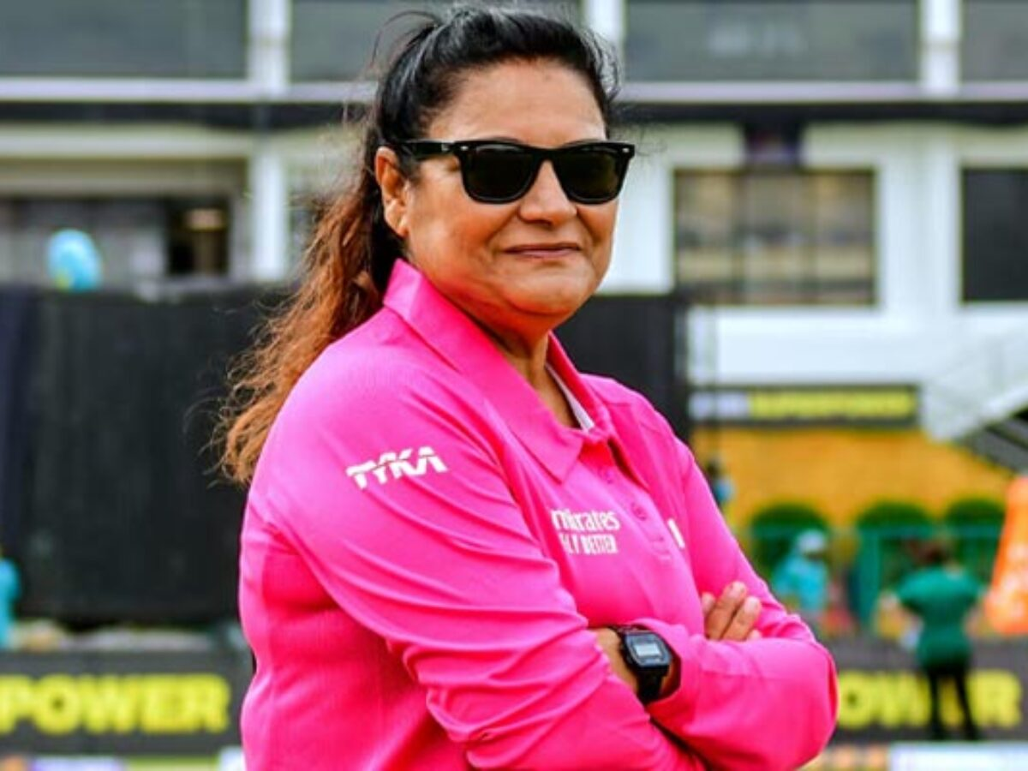
Saleema Imtiaz: First Pakistani Woman Nominated to ICC International Panel of Development Umpires
Saleema Imtiaz has made history by becoming the first Pakistani woman to be nominated to the ICC International Panel of Development Umpires, as announced by the Pakistan Cricket Board (PCB).
Career Highlights
Umpiring Background: Saleema began her career with the PCB women's panel in 2008.

Slide 10
World Rose Day: September 22
World Rose Day is observed every year on September 22, dedicated to honouring and supporting cancer patients globally.
This day serves as a reminder of the courage and bravery shown by those battling cancer and their caregivers.

Slide 11
International Day of Sign Languages: September 23
The International Day of Sign Languages is celebrated annually on September 23 to promote awareness of sign languages and the rights of deaf individuals.
This year’s theme is “Sign up for Sign Language Rights.”

Slide 12
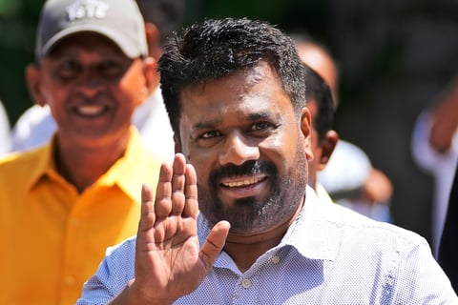
Marxist leader Anura Dissanayake elected as Sri Lanka's president
Anura Kumara Dissanayake, leader of the Marxist Janatha Vimukthi Peramuna (JVP) and National
People's Power (NPP), won the Sri Lankan presidential election.
He was declared the winner after an unprecedented second round of counting by the Election Commission.
He is Sri Lanka's 9th president and the first Marxist to hold the position.
About Sri Lanka :
Capital : Sri Jayawardenepura KotteColombo
Currency : Sri Lankan rupee

Slide 13
Newly Discovered Asteroid 2024 PT5 to Temporarily Orbit Earth from September 29 to November 25, 2024
Newly discovered asteroid named 2024 PT5 will temporarily be captured by Earth's gravity and orbit the planet from September 29 to November 25, 2024.
After this, it will return to a heliocentric orbit (orbit around the sun).
Key Highlights :
Origin of Asteroid 2024 PT5:The asteroid originated from the Arjuna asteroid belt, which consists of small asteroids with orbits similar to Earth's orbit around the sun.
Discovery & Observations:Astronomers first spotted the asteroid on August 7, 2024 using the NASA-funded ATLAS observatory in South Africa.
The asteroid is estimated to be about 37 feet (11 metres) in diameter, but its size could range from 16 to 138 feet (5 to 42 metres).
Mini-Moon Characteristics:Mini-moons are space objects temporarily captured by a planet's gravity, unlike permanent moons.
Asteroid 2024 PT5 will orbit about 2.6 million miles (4.2 million kilometers) away from Earth, about 10 times the distance between Earth and the Moon.
No danger of collision with Earth over the next few decades.
Previous Mini-Moon:In 2020, astronomers identified another mini-moon named 2020 CD3, which orbited Earth for over a year, making it a long-capture mini-moon.

Slide 14
India Wins First Gold Medal in Women’s Section at 2024 Chess Olympiad
India achieved a historic victory by securing its first-ever gold medal in the women's section of the 2024 Chess Olympiad, held at the SYMA Sports and Conference Centre in Budapest, Hungary.
Key Highlights:
Final Round Victory: In the decisive final round, Divya Deshmukh, Vantika Agrawal, and Harika Dronavalli won their matches, while Vaishali contributed with a draw.

Slide 15
World Rivers Day 2024: September 22
World Rivers Day is celebrated on the fourth Sunday of September of every year.
This year World Rivers Day falls on the 22nd of September.
Theme: ‘Waterways of Life’

Slide 16
ANIMATE 2024: Fostering Creativity Through 2D Animation Hackathon
ANIMATE 2024, a 2D animation hackathon organised by FOSSEE, IIT Bombay, in partnership with Whistling Woods International, concluded with an award ceremony at the Whistling Woods campus.
Participants from across the country, including rural areas, participated in the hackathon.
Event: ANIMATE 2024
Organizer: FOSSEE, IIT Bombay in collaboration with Whistling Woods International
Concluded on: September 20, 2024
Location: Whistling Woods Campus, Mumbai
Key Highlights:
Theme: "Celebrating India's Innovation"

Slide 17
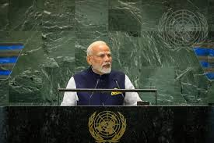
Prime Minister Address at the UN Summit of the Future
Prime Minister Narendra Modi is set to address the UN Summit of the Future in New York, marking the final day of his three-day visit to the U.S.
This comes a day after the UN General Assembly approved a 42-page plan to address global issues like climate change, AI, war, inequality, and poverty.
Summit Highlights:
Theme: “Multilateral Solutions for a Better Tomorrow”
Key Attendees: World leaders such as Iran’s Masoud Pezeshkian, Ukraine’s Volodymyr Zelenskyy, U.S. Secretary of State Antony Blinken, and Russian Deputy Foreign Minister Sergey Vershinin.
Hryvnia

Slide 18
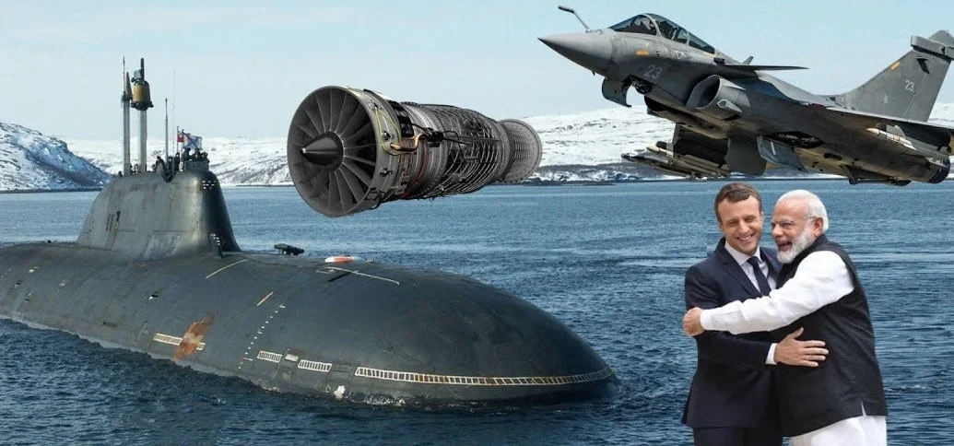
France Commits Comprehensive Support for Nuclear Submarines, Jet Engines, and Underwater Drones to India
The India-France strategic defence partnership is poised for significant advancements, particularly in the construction of nuclear attack submarines and the transfer of technology for aircraft engines and underwater drones.
Discussions between Indian National Security Advisor Ajit Doval and French diplomatic advisor Emmanuel Bonne will take place in Paris from September 30 to October 1, 2024.
France is prepared to offer a 100% transfer of technology for 110 kilo-Newton thrust aircraft engines and advanced underwater drones to India.
This meeting marks the first bilateral strategic engagement following French President Emmanuel Macron's visit to India in January 2024.
About France :
President : Emmanuel Macron
Prime Minister : Michel Barnier
Capital : Paris
Currency : Euro

Slide 19
Unemployment and Labour Force Report: July 2023 - June 2024
Unemployment rate for persons aged 15 years and above has remained unchanged at 3.2 per cent in July 2023 to June 2024, according to the labour force survey annual report released
Key Statistics:
Unemployment Rate (UR):
Remained unchanged at 3.2% for persons aged 15 and above.
Male UR: Slight decline from 3.3% (2022-23) to 3.2% (2023-24).
Female UR: Increased from 2.9% to 3.2% during the same period.
Labour Force Participation Rate (LFPR):
Overall LFPR for persons aged 15+ rose to 60.1% from 57.9% (2022-23).
Male LFPR: Increased slightly from 78.5% to 78.8%.
Female LFPR: Notable rise from 37.0% to 41.7%.
Worker Population Ratio (WPR):
Overall WPR increased to 58.2% from 56.0%.
Male WPR: 76.3%.
Female WPR: Significant rise from 35.9% to 40.3%.
Definitions:
Unemployment Rate (UR): Percentage of unemployed persons in the labour force.
Labour Force Participation Rate (LFPR): Percentage of people working or seeking work in the total population.
Worker Population Ratio (WPR): Percentage of employed persons in the total population.
PLFS Overview:
Periodic Labour Force Survey (PLFS) was launched in April 2017 to provide regular updates on employment and unemployment.

Slide 20
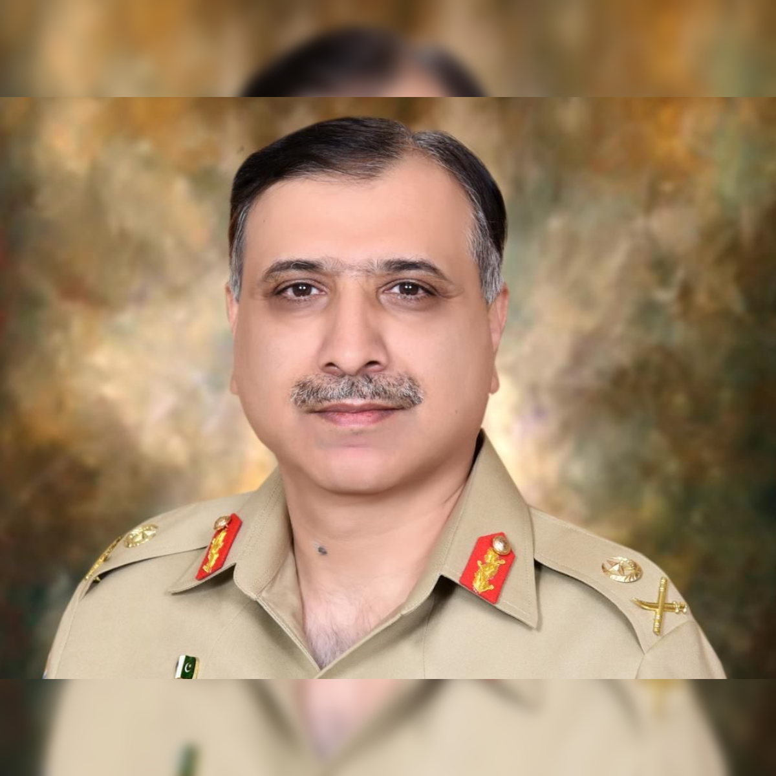
Lieutenant General Muhammad Asim Malik appointed as the new Director General of Pakistan's Inter-Services Intelligence agency
Lieutenant General Muhammad Asim Malik has been
appointed as the new Director General of Pakistan’s spy agency – Inter-Services Intelligence (ISI).
He will assume office on September 30, 2024, replacing the current DG, Lt Gen Nadeem Anjum.
About Inter-Services Intelligence :
Formed : 1 January 1948
Headquarters : Islamabad, Pakistan
The ISI is the largest and best-known component of the Pakistani intelligence community.

Slide 21
Kiran Rao’s Laapataa Ladies Selected as India’s Official Entry for Oscars 2025
Filmmaker Kiran Rao’s comedy-drama “Laapataa Ladies” has been chosen and submitted as India's official entry in the Best Foreign Film Category for the Oscars 2025 by the Film Federation of India.
Overview
Film: Laapataa Ladies
Director: Kiran Rao
Category: Best Foreign Film
Submitted by: Film Federation of India (FFI)
Oscars Date: March 2025

Slide 22
World Pharmacists Day 2024: September 25
Every year we observe 25th September as World
Pharmacists Day.
This year, the theme of World Pharmacy Day is “Pharmacists: Meeting Global Health Needs”.

Slide 23
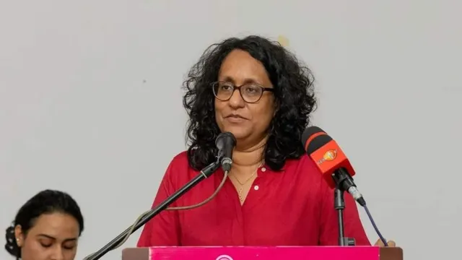
First-Time Lawmaker Harini Amarasuriya Sworn in as Sri Lanka's First Woman Prime Minister in 24 Years
Harini Amarasuriya, a 54-year-old lawmaker and university professor, has been sworn in as Sri Lanka's 16th Prime Minister.
Amarasuriya is the leader of the National People's Power (NPP) party.
Harini is the first woman prime minister of Sri Lanka since the late Sirimavo Bandaranaike took up office in 1994 and the third female prime minister in Sri Lanka’s history.
She replaces Dinesh Gunawardena, who resigned following the recent presidential election.

Slide 24
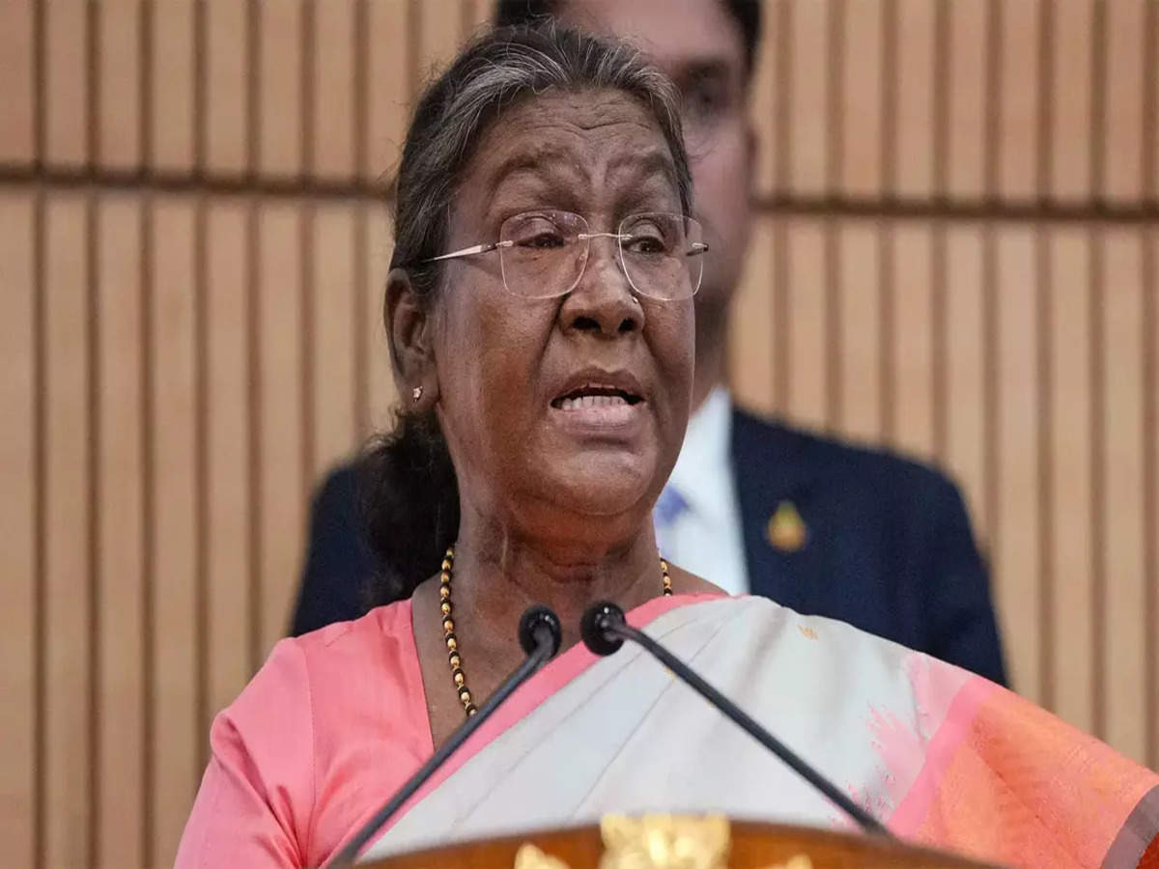
President Droupadi Murmu to Inaugurate the 16th ASOSAI Assembly in New Delhi
President Droupadi Murmu will inaugurate the 16th Assembly of the Asian Organization of Supreme Audit Institutions (ASOSAI) in New Delhi.
The assembly will focus on the evolving role of Supreme Audit Institutions (SAIs) in promoting transparency and accountability.
Chairmanship of ASOSAI:
Girish Chandra Murmu, the Comptroller and Auditor General (CAG) of India, will assume the ASOSAI chair for the term 2024-2027.
His leadership is expected to drive advancements in public auditing and strengthen governance frameworks across Asia.
Participation and Agenda:
The assembly, hosted by the CAG of India, will be held from September 24-27, 2024, with over 200 delegates from 42 countries and international organizations participating.
Historical Significance of ASOSAI:
ASOSAI was founded in 1979 with 11 member institutions and has grown to include 48 Supreme Audit Institutions (SAIs).
ASOSAI is a regional group within the International Organization of Supreme Audit Institutions (INTOSAI).
The first ASOSAI Assembly took place in New Delhi in May 1979;

Slide 25
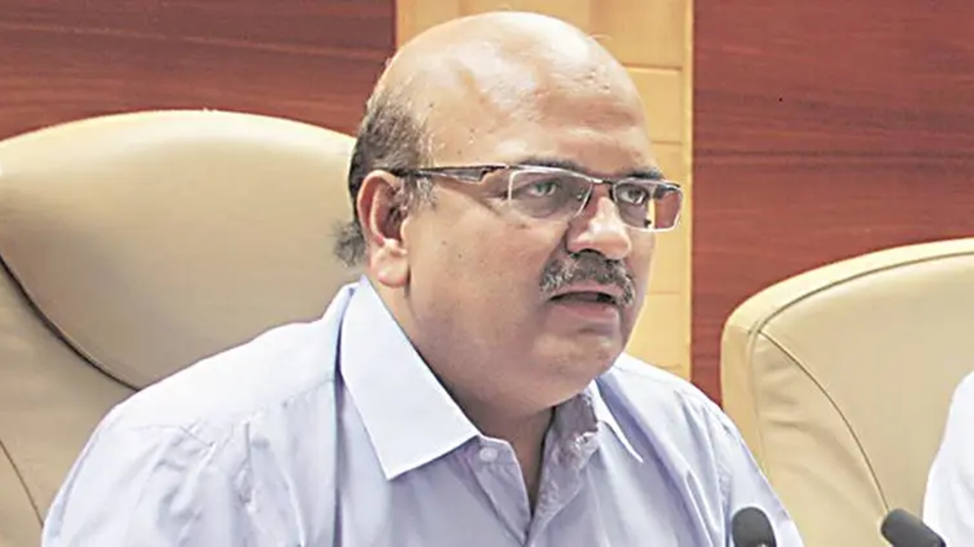
Alok Ranjan named National Crime Records Bureau Director, Amit Garg appointed as National Police Academy Chief
Alok Ranjan, a 1991-batch Indian Police Service (IPS) officer of Madhya Pradesh cadre, has been appointed as the Director, National Crime Records Bureau (NCRB) for a tenure up to his superannuation on June 30, 2026.
Garg, a 1993-batch IPS officer of Andhra Pradesh cadre, has been appointed as the Director, Sardar Vallabhbhai Patel National Police Academy (SVPNPA) for a term up to his retirement on October 31, 2027.
About NCRB :
Formed : 11 March 1986
Headquarters : Delhi, India
Parent Department : Ministry of Home Affairs
NCRB is an Indian government agency responsible for collecting and analyzing crime data as defined by the Indian Penal Code (IPC) and Special and Local Laws (SLL).

Slide 26
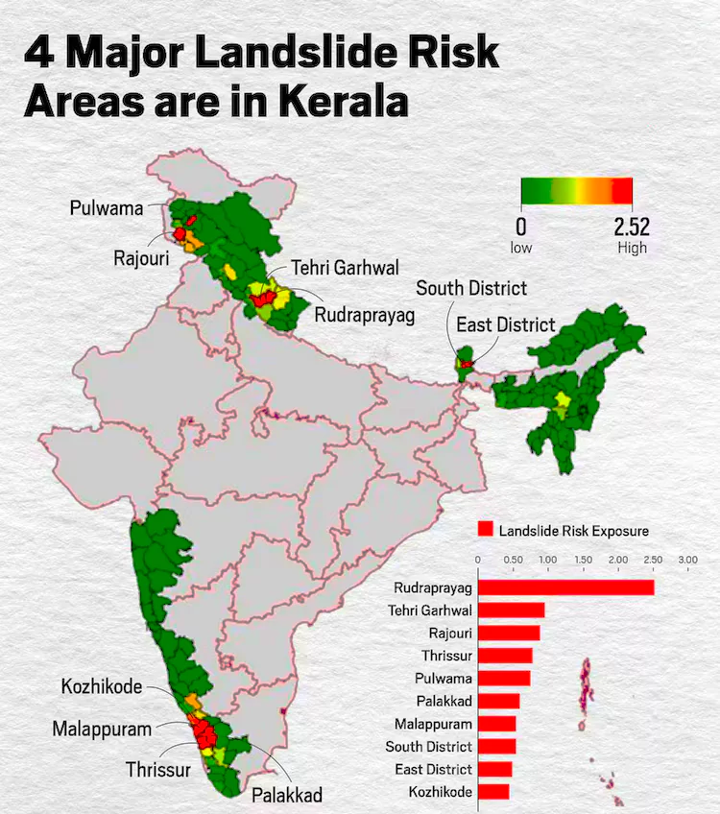
Wayanad Ranks Fifth in Kerala for Landslide Susceptibility in ISRO's 2023 Landslide Atlas
In the 2023 Landslide Atlas of India prepared by
ISRO's National Remote Sensing Centre (NRSC), Wayanad ranks fifth in Kerala and 13th nationally out of 147 districts across 17 states and two Union Territories.
Wayanad’s landslide risk was highlighted after the July 30, 2024 disaster, underscoring the district's vulnerability to such events.
Other Highly Prone Districts in Kerala:
Other districts in Kerala identified as highly susceptible to landslides include:
Thrissur (3rd nationally)
Palakkad (5th nationally)
Malappuram (7th nationally)
Kozhikode (10th nationally)
India’s Most Vulnerable District - Rudraprayag

Slide 27
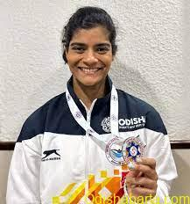
Pratyasa Ray Wins 32nd Ekalabya Puraskar for 2024 for Swimming Achievements
Pratyasa Ray, an emerging swimming talent from Odisha, has been selected for the prestigious 32nd Ekalabya Puraskar 2024 for her outstanding achievements in swimming.
Ekalabya Puraskar:
Instituted by Indian Metals Public Charitable Trust (IMPaCT) in 1993, this award is managed by IMFA, a leading ferro alloys producer in India.
The award is considered Odisha’s most prestigious sports award and is given annually to young sportspersons for their achievements over the previous two years.

Slide 28
Antyodaya Diwas 2024: September 25
The Antyodaya Diwas is observed every year on 25th September in India.
The theme of 2024 is “Empowering the Last Person.”
This day is celebrated on September 25 to mark the birth anniversary of Pandit Deendayal Upadhyaya.
Pandit Deendayal Upadhyaya was born on 25th September 1916 in Mathura.

Slide 29
World Contraception Day 2024: September 26
The World Contraception Day is observed on 26th September of every year.
This day is observed to spread awareness about the available contraceptive methods.
This year, 2024, the theme of World Contraception Day is "A choice for all. Freedom to plan, power to choose."

Slide 30
World Environmental Health Day 2024: September 26
World Environmental Health Day is observed on the 26th
of September of every year.
This day is observed in order to spread awareness about environmental health worldwide.
World Environmental Health Day was established by the International Federation of Environmental Health(IFEH) on 26th September 2011.

Slide 31
Prime Minister Shri Narendra Modi Presents US President Mr. Joe Biden with Antique Silver Hand-Engraved Train Model
Prime Minister Shri Narendra Modi presented gifts to United States (US) President Mr Joe Biden and First Lady Jill Biden, symbolizing India's rich cultural heritage.
President Biden received an antique silver, hand-engraved train model with "Delhi-Delaware" inscribed on the main carriage, signifying strong India-US ties.
First Lady Jill Biden was gifted a Pashmina shawl in an intricately designed Papier Mache box.

Slide 32
Ship-Building and Repair Clusters in Five States, Major Maritime Developments Announced
The Ministry of Ports, Shipping and Waterways
(MoPSW) announced the establishment of ship-building and repair clusters in five states: Gujarat, Andhra Pradesh, Maharashtra, Kerala, and Odisha.
These clusters aim to enhance the strategic importance of India's shipbuilding and ship repair industry.

Slide 33
Ministry of Textiles introduces Quality Control Order for Medical Textiles to enhance Public Health and Safety
The Ministry of Textiles has announced the Medical Textiles (Quality Control) Order, 2023, which will come into effect on October 1, 2024.
This landmark initiative aims to establish stringent quality standards for critical medical textile products.
Scope of the Regulation
The Quality Control Order (QCO) applies to essential medical textile products including:
Sanitary Napkins
Baby Diapers
Reusable Sanitary Pads
Dental Bibs
Objectives and Compliance
Mandatory Certifications: To ensure that these products consistently meet essential quality benchmarks.
Exemptions: Small-scale enterprises and Self-Help
Groups (SHGs) are exempt from the QCO requirements to address potential challenges.

Slide 34
Uttar Pradesh International Trade Show-2024
Uttar Pradesh (U.P.) has the largest base of Micro, Small, and Medium Enterprises (MSMEs) in India, with 96 lakh MSME units spread across 75 districts.
MSMEs are the second-largest job creators in the U.P. after agriculture, playing a major role in the state's industrial transformation.
Key Highlights :
One District One Product (ODOP) Scheme: U.P.’s ODOP scheme promotes unique products from each of the 75 districts, boosting local industries.
11 airports are operational, with work progressing on 10 others.
4 international airports are functional, with Noida International Airport (Jewar) expected to be completed by the end of the year.
The Ganga Expressway, the longest in the country, is expected to be completed before the Prayagraj Mahakumbh in 2025.
About UP :
Governor : Anandiben Patel
Chief Minister : Yogi Adityanath
Capital : Lucknow

Slide 35
Airtel Launches India’s First AI-Powered Spam Detection Solution
In a groundbreaking initiative to tackle the growing issue of spam calls and messages in India, Bharti Airtel has launched the country’s first network-based, AI-powered spam detection solution.
This pioneering tool aims to reduce spam communication for its customers significantly.
Real-Time Alerts: The solution notifies customers in real-time about suspected spam calls and SMS, enhancing protection against unwanted communications.
Automatic Activation: The spam detection service is free of charge and will be automatically activated for all Airtel customers, eliminating the need for service requests or app downloads.

Slide 36
Indian Navy Set to Host the 5th edition of Goa Maritime Symposium
The 5th edition of Goa Maritime Symposium (GMS) 2024 was hosted by the Indian Navy from 23-24 September 24 under the aegis of Naval War College, Goa.
This edition of the Goa Maritime Symposium was conducted in the newly inaugurated, state-of-the-art Chola building of the Naval War College.
Goa Maritime Symposium 2024 is a forum for fostering collaborative thinking, cooperation, and mutual
understanding between India and key maritime nations of the Indian Ocean Region.
Theme : The theme for GMS 2024 was "Common Maritime Security Challenges in the Indian Ocean Region (IOR) – Progressing Lines of Effort to Mitigate Dynamic Threats such as IUU Fishing and Other Illegal Maritime Activities."
About Goa Maritime Symposium (GMS) :
It was conceptualised and instituted by the Indian Navy in 2016.
The symposium is conducted biennially by the Naval War College (NWC), Goa.

Slide 37
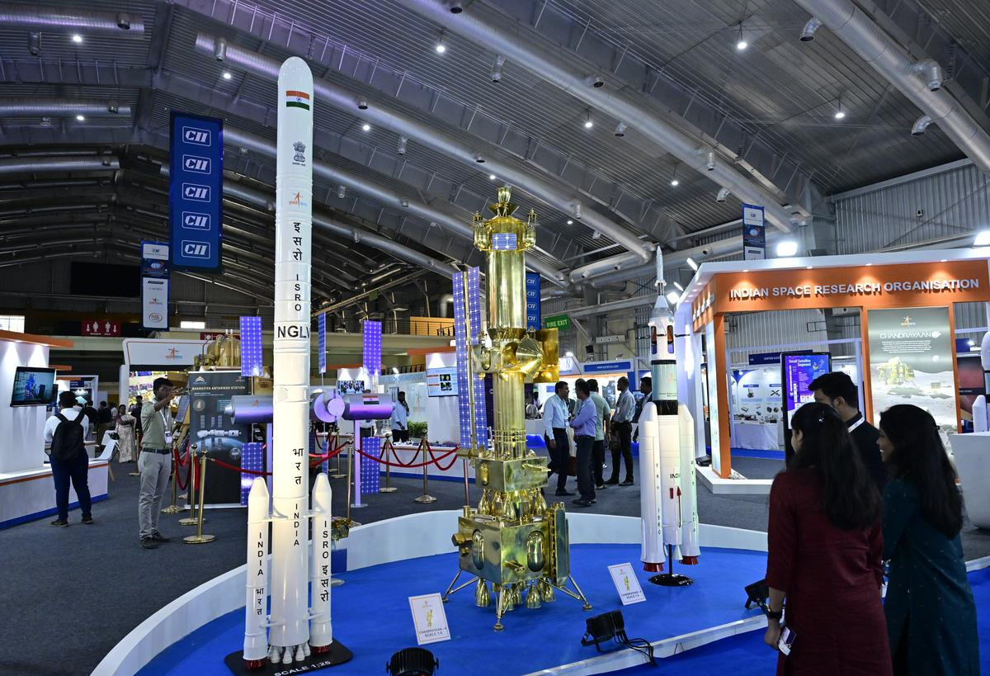
Bengaluru Startup Bellatrix Aerospace Launches Project 200:
Bengaluru-based space startup Bellatrix Aerospace unveiled Project 200, an innovative satellite designed to operate at an Ultra-Low Earth Orbit (180 km-250 km) on the inaugural day of the Bengaluru Space Expo 2024.
Traditionally, satellites have been deployed in orbits at altitudes well above 450 km.
Though it is known that a satellite’s capabilities improve significantly at 200 km, limitations on propulsion technology have prevented satellites from operating at this orbit.
According to Bellatrix, at 200 km, a satellite’s capability would improve significantly since the communication latency is reduced by half and image resolution is improved by three times.
The cost of the satellite is also less when compared to spacecraft placed in 450 km orbits.
About Bellatrix Aerospace :
Founded : 2015
Headquarters : Bangalore, Karnataka, India
Founders : Rohan M Ganapathy, Yashas Karanam

Slide 38
International Day for the Total Elimination of Nuclear Weapons: September 26
The International Day for the Total Elimination of Nuclear Weapons is celebrated on September 26th every year to raise awareness about the threat of nuclear weapons and to promote their elimination.
World Maritime Day 2024: September 26, 2024
World Maritime Day, observed annually on the last Thursday of September, This year, the World Maritime Day is taking place on September 26
Recognize and honour the contributions of those in the maritime industry, including seafarers, marine officials, and service agents.
Theme for 2024
Theme: “Navigating the Future: Safety First!”

Slide 39
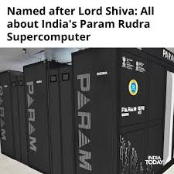
World Tourism Day 2024: September 27
World Tourism Day is celebrated annually on 27th September. For 2024, the host country is Tbilisi, Georgia, and the theme is "Tourism and Peace".
Prime Minister Narendra Modi unveiled three advanced supercomputers named Param Rudra
Prime Minister Narendra Modi unveiled three advanced supercomputers named Param Rudra as part of India's National Supercomputing Mission.
Supercomputers' Placement and Investment
Location: Strategically placed in Pune, Delhi, and Kolkata.
Investment: Built with a collective investment of Rs 130 crore.
Technological Impact
Transformational Benefits: These supercomputers will accelerate research in fields such as healthcare, space exploration, material science, atomic physics, and cosmology.

Slide 40
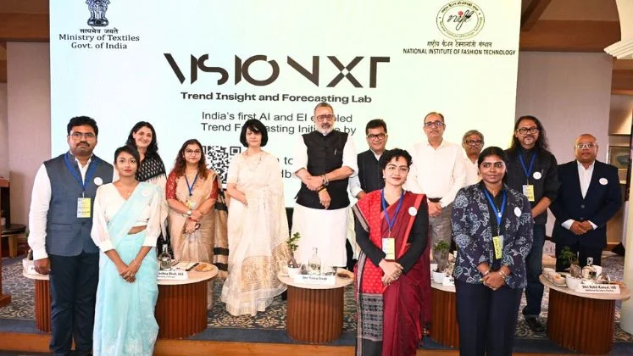
Launch of India-Specific Fashion Initiatives: "Paridhi 24×25" and VisioNxt
Union Minister of Textiles, Shri Giriraj Singh, and Union Minister of State for External Affairs & Textiles, Pabitra Margherita, launched several significant initiatives to enhance India’s fashion and textile sectors, including:
"Paridhi 24×25" Fashion Trend Book
VisioNxt Bilingual Web Portal
AI Taxonomy E-Book

Slide 41
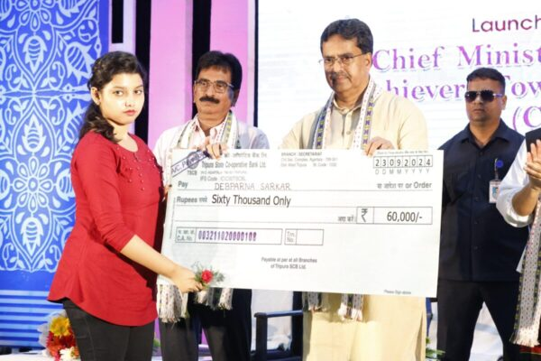
Tripura Government Introduces CM-SATH Scheme to Support Meritorious Students in Pursuing Higher Education
The Chief Minister of Tripura, Manik Saha, launched the CM-SATH scheme to support meritorious students in higher education, fulfilling a pre-poll promise.
The scheme offers financial aid of ₹60,000 (₹5,000 monthly) for a duration of two to three years to 200 selected students based on merit.
About Tripura :
Governor : Indrasena Reddy
Chief Minister : Manik Saha
Capital : Agartala

Slide 42
DRDO and IIT-Delhi Collaborate to Create Lightweight Bulletproof Jackets Named ABHED
The Defence Research & Development Organisation (DRDO), along with researchers of Indian Institute of Technology (IIT) Delhi has developed Light Weight Bullet Proof Jackets named ABHED (Advanced Ballistics for High Energy Defeat).
The jackets have been developed at the DRDO Industry Academia Centre of Excellence (DIA-CoE) at IIT, Delhi.

Slide 43
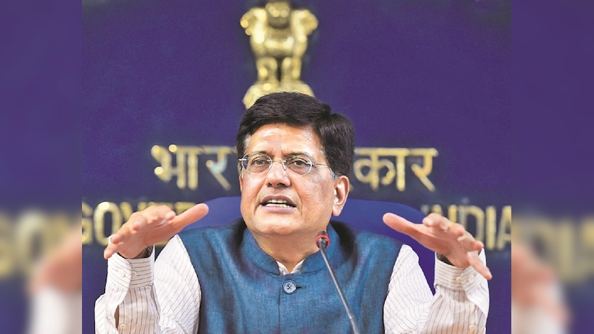
India climbs one position to 39th rank in Global Innovation Index 2024
India has achieved a significant milestone by climbing to the 39th position among 133 global economies in the Global Innovation Index (GII) 2024, as announced by Union Minister Piyush Goyal.
This advancement highlights India’s leadership in the Central and Southern Asia region and its dominance among lower-middle-income economies.
Global Rankings of Top Innovators:
Switzerland
Sweden
United States
United Kingdom
Singapore
Finland
Netherlands
Germany
Denmark
Republic of Korea

Slide 44
IMD World Talent Ranking 2024: Switzerland Retains Top Spot, India Declines in Global Competitiveness
The IMD World Talent Ranking 2024 has revealed significant insights into global talent hubs, with Switzerland maintaining its lead in investment, development, and appeal factors.
The IMD World Talent Ranking 2024 shows the overall ranking for 67 economies.
The economies are ranked from the most to the least competitive, and the change from the Previous year’s rankings is also shown.
Top Talent Hubs:
Switzerland
Singapore: Climbed from 18th in 2014 to 2nd
Luxembourg
Sweden
Denmark
Iceland
Norway
Netherlands
Hong Kong SAR
Austria
India's Performance:
Global Rank: 58th, down from 56th last year and 52nd in 2022, with a talent score of 40.47.

Slide 45
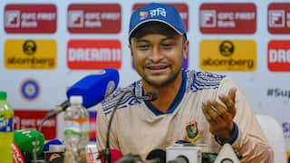
Shakib Al Hasan Announces Retirement from T20I and Future Plans in Cricket
Former Bangladesh 37-year-old skipper and all-rounder Shakib Al Hasan has officially retired from T20I cricket after featuring in 129 matches.
In addition, he has expressed his desire to retire from Test cricket following the home series against South Africa next month in Mirpur.
World Rabies Day 2024: September 28
World Rabies Day is celebrated on 28th September of every year.
This year's World Rabies Day theme is: “Breaking Rabies Boundaries”
The Global Alliance for Rabies Control (GARC) established World Rabies Day in 2007.
This day was recognized by the World Health Organization(WHO).

Slide 46
Ministry of Tourism Announces Winners of the Best Tourism Villages Competition 2024
On 27th September 2024, in celebration of World Tourism Day, the Ministry of Tourism, Government of India revealed the Best Tourism Villages Competition 2024 winners.
Launched in 2023, this competition highlights villages that exemplify cultural and natural preservation, community-based values, and sustainability.
List of Winners by Category:
Adventure Tourism
Dhudmaras (Chhattisgarh)
Aru (Jammu & Kashmir)
Agri Tourism
Kumarakom (Kerala)
Karde (Maharashtra)
Community-Based Tourism
Chitrakote (Chhattisgarh)
Minicoy Island (Lakshadweep)
Craft Tourism
Sualkuchi (Assam)
Pranpur (Madhya Pradesh)
Heritage Tourism
Hafeshwar (Gujarat)
Andro (Manipur)
Responsible Tourism
Dudhani (Dadra and Nagar Haveli and Daman and Diu)
Kadalundi (Kerala)
Spiritual and Wellness Tourism
Ahobilam (Andhra Pradesh)
Bandora (Goa)
Vibrant Village
Harsil (Uttarakhand)
Gunji (Uttarakhand)

Slide 47
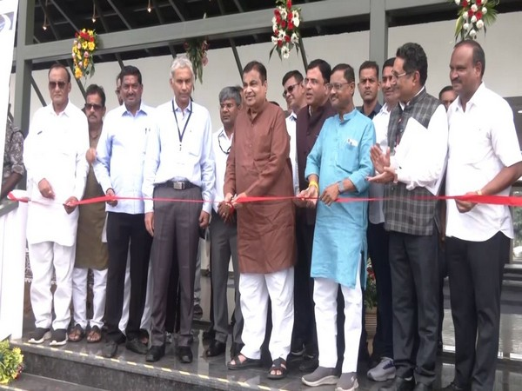
Inauguration of Oxygen Bird Park (Amrit Mahotsav Park) by Union Minister Nitin Gadkari
Union Minister for Road, Transport and Highways, Shri Nitin Gadkari, is set to inaugurate the Oxygen Bird Park (Amrit Mahotsav Park) located on the Nagpur-Hyderabad National Highway 44 in Nagpur, Maharashtra.
The park is designed to attract bird populations, creating a flourishing habitat for diverse bird species while promoting ecological balance.

Slide 48
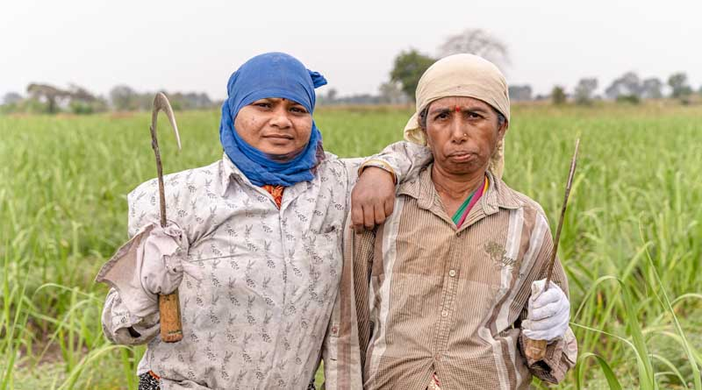
Uttar Pradesh introduces Krishi Sakhi scheme to empower women in agriculture
The "Krishi Sakhi" scheme was launched in Uttar Pradesh (UP) to empower women in agriculture.
The scheme aims to promote self-reliance and improve economic status through modern agricultural practices.
Selection Criteria:Women aged between 21 to 45 years with an interest and experience in agriculture are eligible for selection.
Training Body:TheNational Institute of Agricultural Extension Management (MANAGE) is responsible for training Krishi Sakhis.

Slide 49
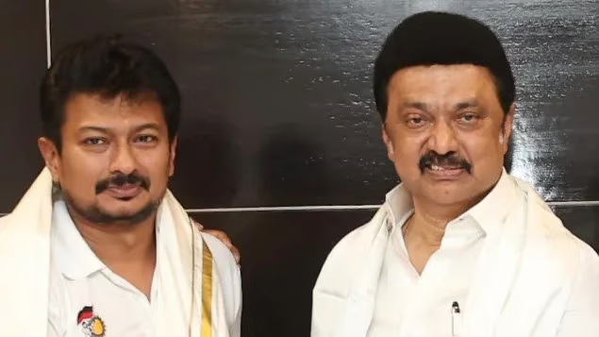
Tamil Nadu Cabinet Reshuffle: Udhayanidhi Stalin Appointed as Deputy Chief Minister, Senthil Balaji Rejoins Cabinet
Udhayanidhi Stalin, the 45-year-old son of Chief Minister M K Stalin, was elevated to the post of Deputy Chief Minister of Tamil Nadu.
Udhayanidhi is a first-time MLA from Chepauk and previously served as the Minister for Youth Welfare and Sports Development.
The promotion signals his growing influence within the DMK party and Tamil Nadu government.
About Tamil Nadu :
Governor: R. N. Ravi
Chief minister: M. K. Stalin
Capital: Chennai
Dance : Bharatnatyam, Karakattam

Slide 50
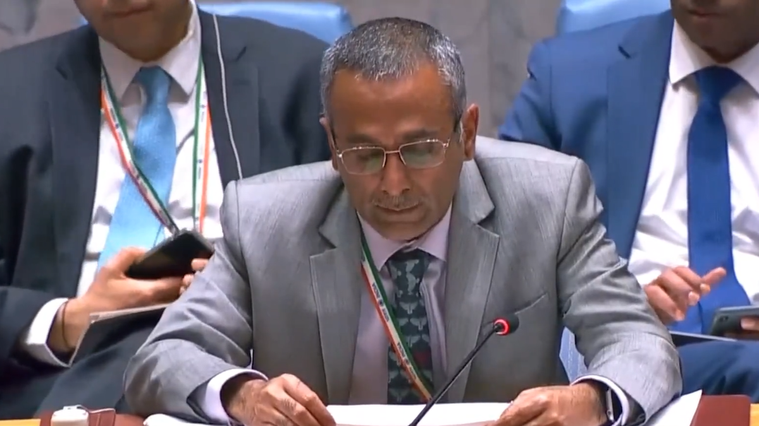
R.Ravindra named as India's new Ambassador to Iceland
Ravindra has been appointed as India's next Ambassador to Iceland by the Ministry of External Affairs.
Prior to this appointment, he served as the Deputy Permanent Representative of India to the United Nations in New York.
Ravindra succeeds Mr. B. Shyam as the ambassador to Iceland.
About Iceland :
President : Halla Tómasdóttir
Prime Minister : Bjarni Benediktsson
Capital : Reykjavík
Currency : Icelandic króna

Slide 51
Lay’s Becomes Official Sponsor of FIFA World Cup 2026 and FIFA Women’s World Cup 2027
Lay’s has become the official sponsor for both the FIFA World Cup 2026 and the FIFA Women’s World Cup 2027.
World Heart Day 2024: September 29
Every year World Heart Day is celebrated on 29th September.
The heart is the primary organ of the circulatory system. It is located between the lungs, in the middle compartment of the chest.
The World Heart Federation (WHF) has announced a powerful theme for the years 2024 to 2026: “Use Heart for Action.”

Slide 52
International Translation Day 2024: September 30
International Translation Day is celebrated on 30th September of every year.
The theme for International Translation Day (ITD) in 2024 is "Translation, an art worth protecting".

